Slide 1



Slide 2
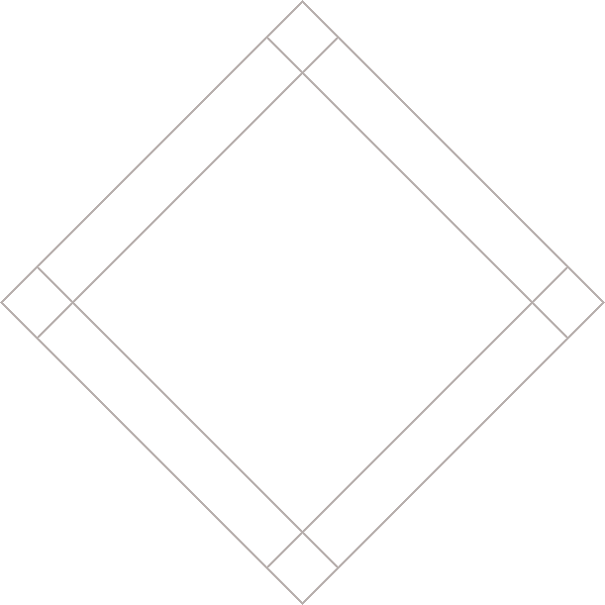


Slide 3
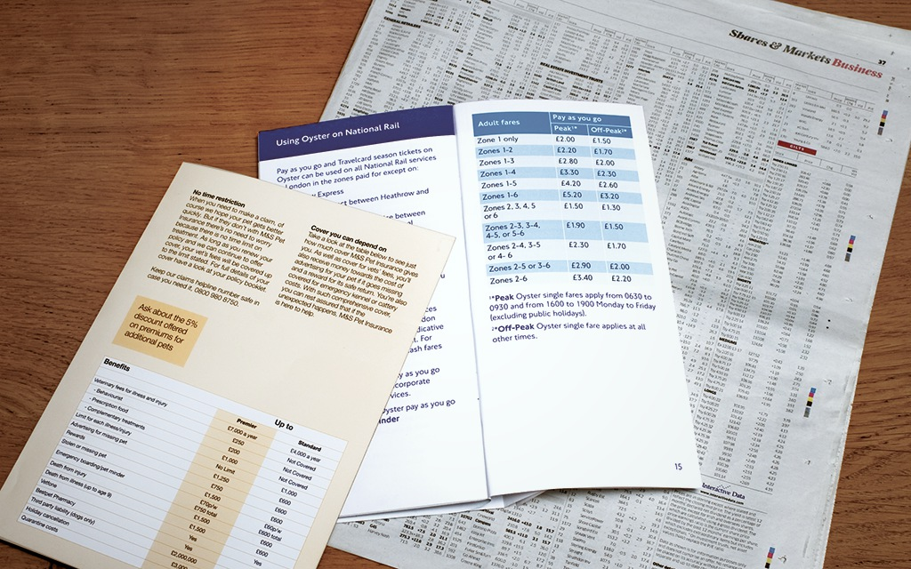
WHAT'S A TABLE?
Notes:
Explain: The types of information commonly displayed in tables include stocks and shares, sports results, train timetables and price lists.

Slide 4
BASIC TABLE STRUCTURE
<table>
<tr>
<td>15</td>
<td>15</td>
<td>30</td>
</tr>
<tr>
<td>45</td>
<td>60</td>
<td>90</td>
</tr>
</table>
Notes:
Explain: Tables are drawn out one row at a time.

Slide 5
BASIC TABLE STRUCTURE
<table>
<tr>
<td>15</td>
<td>15</td>
<td>30</td>
</tr>
<tr>
<td>45</td>
<td>60</td>
<td>90</td>
</tr>
</table>

Slide 6
BASIC TABLE STRUCTURE
<table>
<tr>
<td>15</td>
<td>15</td>
<td>30</td>
</tr>
<tr>
<td>45</td>
<td>60</td>
<td>90</td>
</tr>
</table>
Notes:
Explain: The "tr" in the <tr> tag stands for "table row".

Slide 7
BASIC TABLE STRUCTURE
<table>
<tr>
<td>15</td>
<td>15</td>
<td>30</td>
</tr>
<tr>
<td>45</td>
<td>60</td>
<td>90</td>
</tr>
</table>
Notes:
Explain: The "td" in the <td> tag stands for "table data".

Slide 8
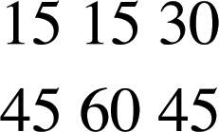

Slide 9
TABLE HEADINGS
<table>
<tr>
<th></th>
<th scope="col">Saturday</th>
<th scope="col">Sunday</th>
</tr>
<tr>
<th scope="row">Tickets sold</th>
<td>120</td>
<td>135</td>
</tr>
</table>
Notes:
Explain: You need to show tags for cells that have no data. For example, this table shows an empty cell on the first <th> element.

Slide 10
TABLE HEADINGS
<table>
<tr>
<th></th>
<th scope="col">Saturday</th>
<th scope="col">Sunday</th>
</tr>
<tr>
<th scope="row">Tickets sold</th>
<td>120</td>
<td>135</td>
</tr>
</table>

Slide 11
TABLE HEADINGS
<table>
<tr>
<th></th>
<th scope="col">Saturday</th>
<th scope="col">Sunday</th>
</tr>
<tr>
<th scope="row">Tickets sold</th>
<td>120</td>
<td>135</td>
</tr>
</table>

Slide 12


Slide 13
SPANNING COLUMNS
...
<tr>
<th>Monday</th>
<td colspan="2">Geography</td>
<td>Math</td>
<td>Art</td>
</tr>
...

Slide 14
SPANNING COLUMNS
...
<tr>
<th>Monday</th>
<td colspan="2">Geography</td>
<td>Math</td>
<td>Art</td>
</tr>
...

Slide 15
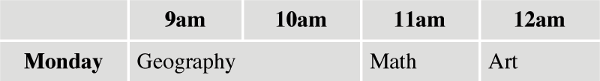

Slide 16
SPANNING ROWS
...
<tr>
<th>6pm - 7pm</th>
<td rowspan="2">Movie</td>
<td>Comedy</td>
<td>News</td>
</tr>
<tr>
<th>7pm - 8pm</th>
<td>Sport</td>
<td>Current Affairs</td>
</tr>

Slide 17
SPANNING ROWS
...
<tr>
<th>6pm - 7pm</th>
<td rowspan="2">Movie</td>
<td>Comedy</td>
<td>News</td>
</tr>
<tr>
<th>7pm - 8pm</th>
<td>Sport</td>
<td>Current Affairs</td>
</tr>

Slide 18
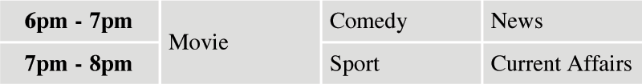

Slide 19
LONG TABLES
<thead>
<tr>
<th>Date</th>
<th>Income</th>
<th>Expenditure</th>
</tr>
</thead>
<tbody>...</tbody>
<tfoot>...</tfoot>
Notes:
Explain: The <thead>, <tbody>, and <tfoot> tags can be used to hold heading, body, and footer information in a long table. For example, it can be used to put a heading and footer on every page of a long table and also to style contents differently than other parts of the table.

Slide 20
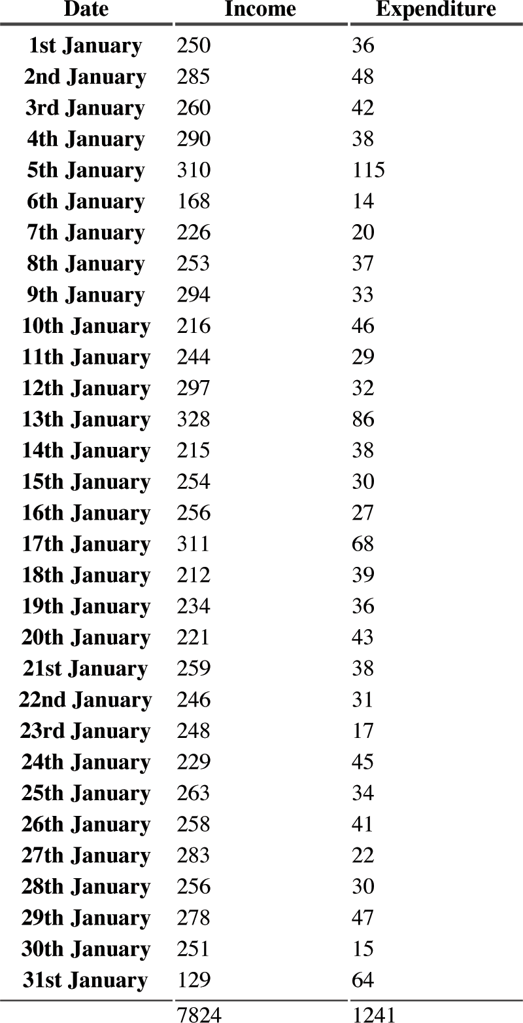

Slide 21
OLD CODE: WIDTH & SPACING
<table width="400"
cellpadding="10"
cellspacing="10">
<tr>
<th width="150"></th>
<th>Withdrawn</th>
<th>Credit</th>
<th>Balance</th>
</tr>
<tr> ... </tr>
</table>
Notes:
Explain: These measurements should actually be done with CSS. It is only shown here because you may see it in older code.

Slide 22
OLD CODE: WIDTH & SPACING
<table width="400"
cellpadding="10"
cellspacing="10">
<tr>
<th width="150"></th>
<th>Withdrawn</th>
<th>Credit</th>
<th>Balance</th>
</tr>
<tr> ... </tr>
</table>

Slide 23
OLD CODE: WIDTH & SPACING
<table width="400"
cellpadding="10"
cellspacing="10">
<tr>
<th width="150"></th>
<th>Withdrawn</th>
<th>Credit</th>
<th>Balance</th>
</tr>
<tr> ... </tr>
</table>

Slide 24
OLD CODE: WIDTH & SPACING
<table width="400"
cellpadding="10"
cellspacing="10">
<tr>
<th width="150"></th>
<th>Withdrawn</th>
<th>Credit</th>
<th>Balance</th>
</tr>
<tr> ... </tr>
</table>

Slide 25
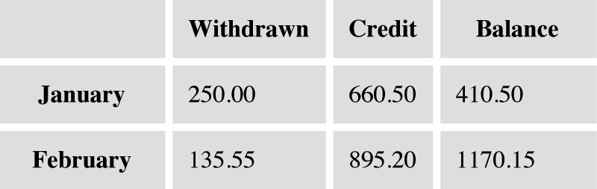

Slide 26
OLD CODE: BORDER & BACKGROUND
<table border="2"
bgcolor="#efefef">
<tr>
<th width="150"></th>
<th>Withdrawn</th>
<th>Credit</th>
<th bgcolor="#cccccc">Balance</th>
</tr>
<tr> ... </tr>
</table>
Notes:
Explain: These borders and backgrounds should actually be done with CSS. It is only shown here because you may see it in older code.

Slide 27
OLD CODE: BORDER & BACKGROUND
<table border="2"
bgcolor="#efefef">
<tr>
<th width="150"></th>
<th>Withdrawn</th>
<th>Credit</th>
<th bgcolor="#cccccc">Balance</th>
</tr>
<tr> ... </tr>
</table>

Slide 28
OLD CODE: BORDER & BACKGROUND
<table border="2"
bgcolor="#efefef">
<tr>
<th width="150"></th>
<th>Withdrawn</th>
<th>Credit</th>
<th bgcolor="#cccccc">Balance</th>
</tr>
<tr> ... </tr>
</table>

Slide 29
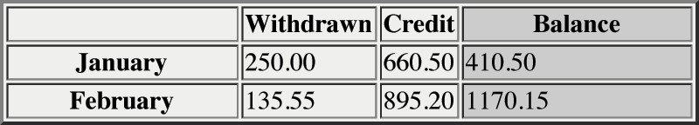

Slide 30
SUMMARY
The <table> element is used to add tables to a
web page.
Notes:
Clicks: Load individual bullets

Slide 31
SUMMARY
A table is drawn out row by row. Each row is created with the <tr> element.
Notes:
Clicks: Load individual bullets

Slide 32
SUMMARY
Inside each row are cells represented by the <td> element (or <th> if it is
a header).
Notes:
Clicks: Load individual bullets

Slide 33
SUMMARY
You can make cells of a table span more than one row or column using the rowspan and colspan attributes.
Notes:
Clicks: Load individual bullets

Slide 34
SUMMARY
For long tables you can split the table into a <thead>, <tbody>, and <tfoot>.
Notes:
Clicks: Load individual bullets

Slide 35
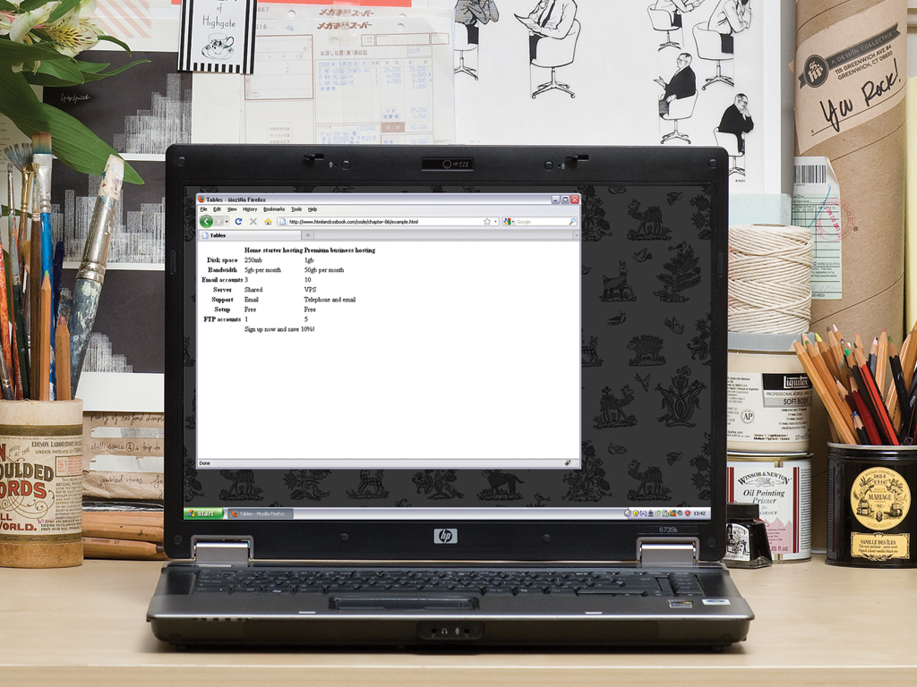

Slide 36


